Slide 1
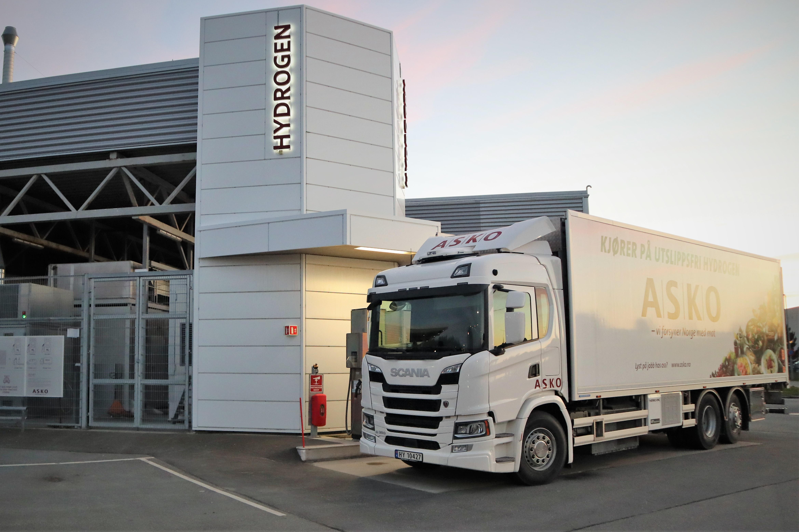

Next Wave
Input to a Nordic Hydrogen Vision
June 2022
Photo: Steinar Aasen, KL

Slide 2
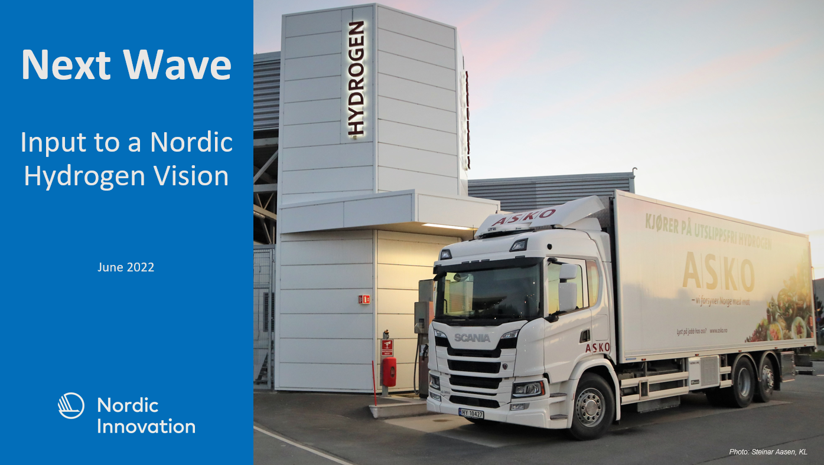
Disclaimer
This publication is part of the Nordic Smart Mobility and Connectivity initiative Next Wave (Next Nordic Green Transport Wave - Large Vehicles) co-financed by Nordic Innovation.
The project partners are responsible for its content.

Slide 3











About Next Wave
Sponsor:
Next Wave focuses on providing infrastructure for a large-scale deployment of hydrogen trucks, buses, and machinery. The goal is to further stimulate the global technological lead, which the Nordic countries have by stimulating the very first hydrogen infrastructure rollout for larger vehicles while at the same time map how the infrastructure build-up best can be done.
Time span: 01.10.2019 – 31.12.2021
Financed by: Nordic Innovation and project partners
Partners:

Slide 4

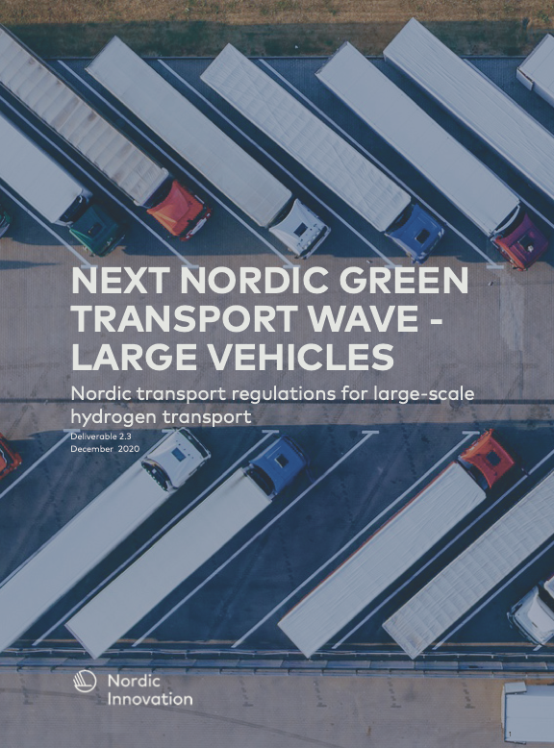

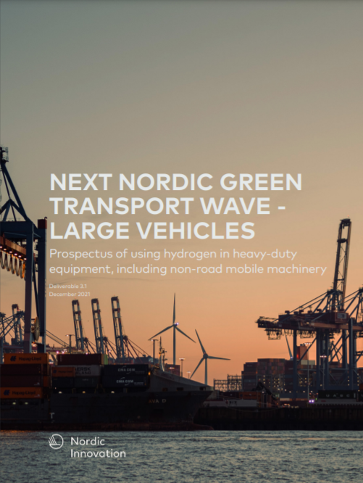


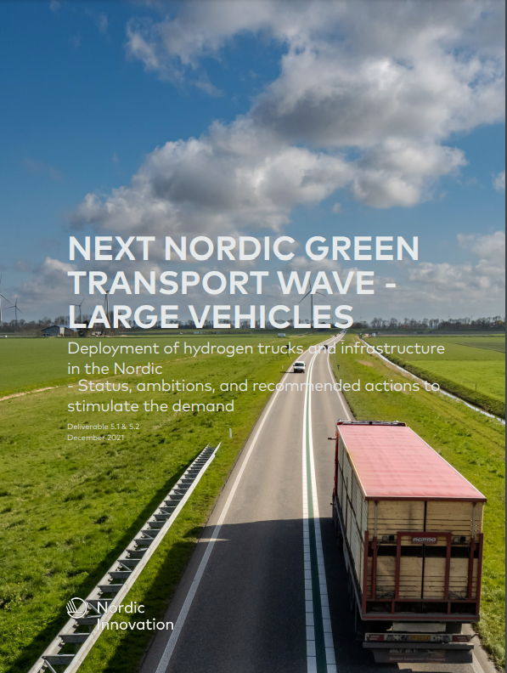
Next Wave Reports
The Next Wave reports represents the most updated and comprehensive work on hydrogen in the Nordics.
Here, you’ll find facts and figures, modelling and analysis , as well as the partners joint ambitions, plans and recommendations – in other words everything that is needed in preparing for implementation.
Thus, Let’s-a go!
The reports are available for download from: http://www.nordichydrogenpartnership.com/nextwave/

Slide 5

The Hydrogen Landscape
National strategies are currently being developed all over the world
European focus: Decarbonising industrial and transport sectors
Status in the Nordics:
  Norway: Strategy (2020) and Roadmap (2021)
  Sweden: Proposed strategy publisher in 2021,
  to be adopted 2022
  Denmark: Strategy adopted 2022
  Finland: National strategy expected 2022
  Iceland: Hydrogen & Electrofuel Roadmap expected to be published 2022

Slide 6

Europe
Hydrogen to play an important role in
  Decarbonisation of the energy system
  Developing European industry
  Fit for 55 – meeting ambitious climate targets
EU´s Hydrogen Strategy – specifying targets for
  Green and blue hydrogen production by 2025 and 2030
  Investments in electrolysers, connection to solar and wind power, transport, distribution, and storage
  Total investments: 320-458 billion Euros until 2030
Germany´s Hydrogen Strategy
  Budget: 9 billion Euros
  38 measures over the complete value chain
  Dedicated work on regulations and directives to stimulate development and deployment of hydrogen stations and vehicles
  Ramp-up of fuel cell applications over all segments and respective infrastructure as well as power-based fuel
  To be updated and upgraded by new government

Slide 7








Standards and Directives Stimulating Transition to Zero-emission
1
CO₂ Emission
Standards – LDVs
2
CO₂ Emission
Standards – HDVs
3
Clean Vehicle Directive
4
Alternative Fuels
Infrastructure Directive*
5
Renewable Energy
Directive
6
Energy Taxation
Directive
Source: Hydrogen Europe
* The directive is changed to a regulative (AFIR), expected to be adopted by the Commission spring 2022.

Slide 8
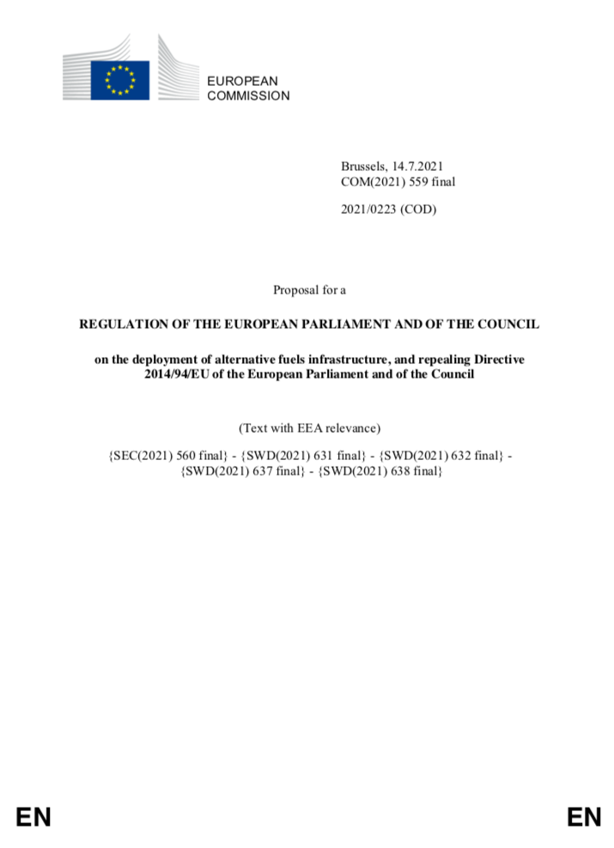
Alternative Fuel Infrastructure Regulation (AFIR)
Proposal to be adopted by the Commission spring 2022
Member States should notify a national policy framework for the development of the market as regards alternative fuels in the transport sector and the deployment of the relevant infrastructure by January 1st 2025
Proposed for hydrogen:
  Member States shall ensure that by 31 December 2030 publicly accessible hydrogen refuelling stations with a minimum capacity of 2 t/day and equipped with at least a 700 bars dispenser are deployed with a maximum distance of 150 km in-between them along the TEN-T core and the TEN-T comprehensive network. Liquid hydrogen shall be made available at publicly accessible refuelling stations with a maximum distance of 450 km in-between them.
  Neighbouring Member States shall ensure that the maximum distance referred to in Paragraph 1, second subparagraph is not exceeded for cross-border sections of the TEN-T core and the TEN-T comprehensive network.
  The operator of a publicly accessible refuelling station shall ensure that the station is designed to serve light-duty and heavy-duty vehicles. In freight terminals, operators or owners of these publicly accessible hydrogen refuelling stations shall ensure that these stations also serve liquid hydrogen.

Slide 9


Norway
Hydrogen Strategy published June 2020
  Public procurement to stimulate zero emission transport
  Prioritizing Industry and maritime transport
  More a description than a strategy; missing ambitions and concrete targets
Hydrogen Roadmap published June 2021
  By 2025:
    5 hydrogen hubs in maritime sector with opportunities for the development of land transport,
    1-2 industry projects,
    5-10 pilot projects
  By 2030:
    Network of hubs with supply to vessels and vehicles,
    hydrogen vessels are competitive and safe,
    realization of full-scale hydrogen projects in the industry,
    use of hydrogen is a competitive alternative to fossil energy,
    export of hydrogen and technologies
2021: New government has taken office. More efforts within hydrogen is expected
  Will build a coherent value chain where hydrogen production, distribution and use are developed in parallel
  Will set a target for annual production of blue and green hydrogen by 2030

Slide 10

Sweden
Swedish Hydrogen Strategy proposal published by National Energy Agency in November 2021, with following guiding principles:
  The use of hydrogen will contribute to the transition to fossil-free society
  The hydrogen gas must be used where it is economically efficient and make the most of system benefits
  Security of supply must be strengthened
  Sweden should be a pioneer internationally
  Sweden will export climate-smart products and services to contribute to elimination of fossil energy abroad
Main intentions:
  Utilise Sweden’s fossil-free electricity mix for building strong position on the international scene
  Explore policy instruments that can help to close the cost gap between fossil- and fossil-free hydrogen
  Systemic view is important to develop cross-sectoral benefits
  Continue building collaboration platforms between industry, academia and public sector
  Take active role in Nordic- and international cooperation
Specific objectives
  By 2030: 5 GW electrolyser capacity installed
  By 2045: 15 GW electrolyser capacity installed

Slide 11

Denmark
National Hydrogen Strategy published by the Government on the 15th of December 2021
  https://kefm.dk/aktuelt/nyheder/2021/dec/regeringen-vil-kickstarte-udvikling-af-groenne-braendstoffer-med-milliardstoette-
  Will provide better access to the electricity grid and enable direct connections between
  RE and H₂-production
  Main focus heavy transport and production of liquid fuels for aviation and shipping and to
  some extend road transport
  Construction of H₂ infrastructure at both DSO and TSO level – connection to Germany and potentially Sweden
Government aims for at least 4-6 GW electrolyser capacity in 2030
Overall project portfolio for planned Hydrogen projects at 6+ GW in December 2021 https://brintbranchen.dk/brintbranchen-praesenterer-brint-i-tal/
Strategy now to be negotiated in Q1 2022 in Parliament
Further build up of RE capacity agreed in order to ensure sufficient supply for H2-production
Separate strategy for ZE heavy duty transport to be developed in 2022

Slide 12
Finland
Finland does not have a separate hydrogen strategy
  Hydrogen is an important part of the national climate and energy strategy of Finland, which will be published Q1 2022
  Business Finland prepared a National Hydrogen Roadmap in November 2020
  Industry drive National Hydrogen Cluster published White paper in September 2020
Hydrogen in Finland has an important role for flexible energy use and decarbonisation of industry
Finland has a goal to have predictable and competitive investment environment for hydrogen economy

Slide 13
Iceland
Vision for H₂ published in 2020
  Icelandic New Energy responsible for the documentation
  Gives insight into the potential role of H₂ until 2030 and even beyond
Hydrogen & Electrofuel Roadmap in the making (initiated by the Government)
  Plans to publish in Q1 2022
  Roland Berger (author) hosted a stakeholder forum in October 2021 to get feedback
  Includes vision for use of H₂ and electrofuels to replace all use of fossil fuel with a vision, 2030; again 2040, and finally 2050
    Includes target goals for the maritime sector, aviation, and land transport
  Iceland was a pioneer and already restarted:
    Two refuelling stations are in operation
    Small fleet of FCEVs is being tested
    Investment policy and incentives – hopefully based on the Roadmap – will determine speed of deployment
2021: New government has taken office. Very high emphasis on energy shift in all sectors, goal to be fossil fuel free by 2040
  Hydrogen will play an important role

Slide 14
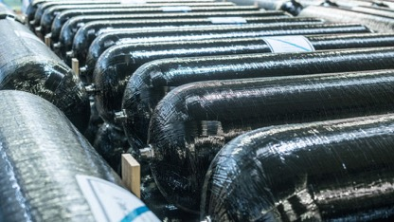

Nordic Hydrogen Industry in Lead Position
Developing world-leading hydrogen technology
  Electrolysers
  Storage and transport systems
  Hydrogen stations
Use of hydrogen in industry
  Zero emission steel manufacturing
  Ammonia and fertilizers
  e-fuels
Hydrogen production
  Green hydrogen
  Blue hydrogen
Photo: Hexagon Purus
Photo: SSAB

Slide 15
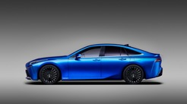
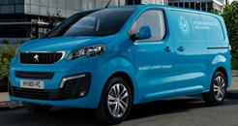
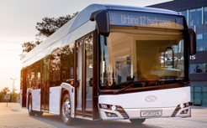
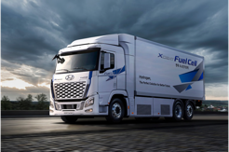
Status: Vehicles
Passenger vehicles
  Available: Toyota Mirai and Hyundai Nexo. Range: ~650 km.
  Expected: Limited series from some OEMs. Small volumes the next years.
Vans
  Available: Peugeot e-Expert, Opel Vivaro, Hyvia (France), Gaz (Russia),
  Renault Kangoo and Master. Range ~450 km.
  Expected: Quantron, Hyzon, and H2X.
Trucks
  Available: Hyundai XCient, Hyzon. Range: ~400 km.
  Expected: Quantron (2022), Scania (2023, limited series), Iveco / Nikola (2024),
  Volvo (2025), Mercedes (2025).
Buses
  Available: Solaris, Van Hool, Alexander Dennis, Caetanobus, Citaro, Wright. Range: ~350 km.
  Expected: Quantron (2022) and H2X.
Photo: Toyota, Peugeot, Solaris, Hyundai

Slide 16
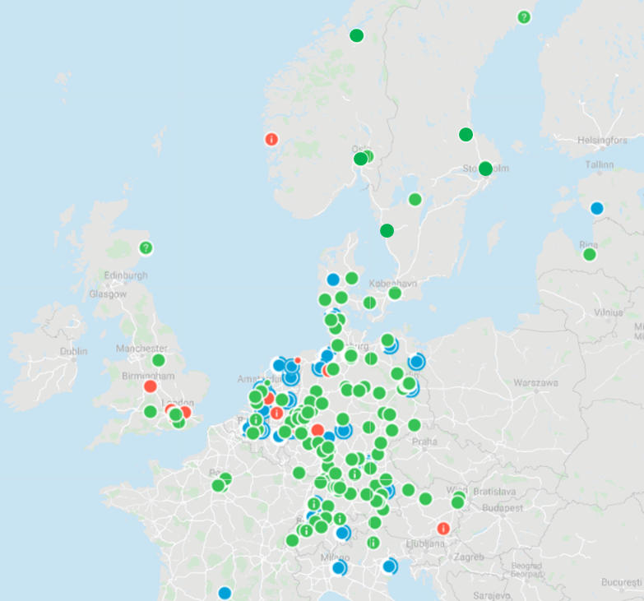

Status:
Infrastructure (Dec 21st, 2021)
Nordic operators:
  Everfuel, Hynion, VänerEnergi, Linde, Oazer, Orkan, ASKO
Nordic stations for passenger vehicles:
  N (3): Bærum, Lillestrøm, Trondheim (ASKO)
  SE: (4) Gothenburg, Arlanda, Mariestad, Sandviken
  DK: (6) Århus, Kolding, Esbjerg, Korsør, København (2)
  IS: (2) Reykjavik, Keflavik
Nordic stations for trucks:
  ASKO (N)
  Gothenburg (SE)
Hydrogen stations in Europe
by December 21st 2021
Source: h2.live.
In operation
Temporarily out of order
In preparation

Slide 17
Status: Instruments and Incentives
Incentives: hydrogen for transport | NO | SE | DK | FI | IS
Purchase of trucks | Enova: No specific program, but possible to get 40% of additional cost | Energimyndigheten: 20% funding of investment | No specific subsidies. Strategy for ZE trucks underway in 2022 | No specific subsidy for trucks. Can be a part of larger demo. | 100% depreciation in year 1. No VAT. Reduced annual fee. No excise tax for ZE trucks. No current funding.
Purchase of buses | Same as for trucks | Energimyndigheten: 20% funding of investment from 2022 | Same as trucks – but public tenders almost all ZE | Same as for trucks | Same as for trucks
Hydrogen stations | Enova: No specific program but possible to get 40% of cost. Must be related to purchase of trucks | Naturvårdsverket – Klimatklivet: up to 70% funding of investment | No specific subsidy but tender for ZE infrastructure 72 mill DKK and 225 mill DKK underway | No specific subsidy for HRS. Can be a part of larger demo. | No incentives.
Annual CO₂ tax | Annual tax is 0,- for ZEVs and only 378 NOK for HD diesel trucks. CO2-tax is 159,- NOK/ton (2021) | Currently 107 SEK/g CO2 for range 90-130 g/km and 132 SEK/g for emissions above 130 g/km according to official test cycle | Part of fuel tax – no general Co2-tax but underway as part or “green tax reform” to be negotiated in 2022 | No annual car tax since 1.10.2021 | Gasoil + diesel 11,75 ISK/L Gasoline 10,25 ISK/L Fuel oil 14,45 ISK/kg Fossil gas 12,85 ISK/kg
Toll roads | Exemption | No exemption based on emissions | CO2-based MAUT for trucks planned in principle from 2025 | no toll roads in Finland | Full payment
National ferries | Exemption | No exemption based on emissions | Program underway – tender completed but not yet public | not relevant | Full payment
Zero emission zones | Being considered in some large cities | No zones yet | Legal framework on its way through parliament | No such zones in Finland | N.A.

Slide 18

Necessary Incentives for Hydrogen in Heavy-Duty Transport
Clear national ambitions for decarbonisation of transport
Harmonized incentives across the Nordics
Public funding needed in the early stage
  Purchase trucks, establish stations, production of hydrogen
Long-term benefits for use of hydrogen trucks, i.e.,
  Exemption on toll roads and public ferries
  Exemption of annual fee for trucks
  Introduction of zero-emission zones in cities
  Access to zero-emission lanes, reserved parking, and reserved and timely favoured delivery of goods
Increased CO₂ tax – polluter should pay principle
Cross-border trade of liquid and gaseous hydrogen

Slide 19
Possible Barriers for Hydrogen Heavy-Duty Transport
Availability of trucks
  Small series/numbers available until 2025
  Global competition for the trucks – incentives are important
Availability of infrastructure
  The stations must be in place before the trucks arrive
  Difficult to find areas for energy stations
  Long permitting-times
Lack of TCO and LCA
Incentives not in place
Legislation (“5 kW/ton”-rule)
  Commission regulation (EU) No 1230/2012 “The engine shall provide a power output of at least
  5 kW per ton of the technically permissible maximum laden mass…”

Slide 20
Next Wave Vision
- for Nordic rollout of hydrogen trucks
Background - assumptions
  Trucks will be available from 2023 in limited numbers, but enough to start deployment
  Distribution trucks will be available first
  Trucks for long-haul, including Volvo, Daimler and Iveco and other brands, will be available in large numbers from 2025
  TCO for hydrogen trucks will be equivalent with diesel by 2027 (Source: Roland Berger)
Next Wave ambition
  By 2025
    3,440 trucks deployed in the Nordics (approx. 1,2% of total Nordic stock (~285,000) and 91% of all hydrogen trucks in Europe)
    Hydrogen trucks will be operating regional, national, and cross-border transport
    Heavy-duty paving the way for vans and passenger vehicles
  By 2030
    18,350 trucks deployed in the Nordics (approx. 6,4% of total Nordic stock and 18% of all hydrogen trucks in Europe)

Slide 21
Next Wave Ambition
- for Nordic rollout of hydrogen trucks
Remarks:
The numbers for Denmark is very ambitious and is based on input from the transport industry.
The number for 2025 is relatively low because Swedish transport companies in general are waiting for the hydrogen trucks from Scania and Volvo, which are expected to be available in largest numbers by 2025 onwards.
Finland has a high share of 60+ tonnes trucks, which are only operated in Finland (and to some degree in Sweden). These heavy-duty trucks are not expected to be available with hydrogen in larger numbers before 2030.
For Iceland, the numbers are based on the current regime of investment incentives. The numbers are expected to be much higher if better incentives are made available.

Slide 22

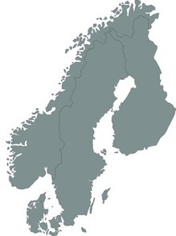
Next Wave Vision
- for Nordic infrastructure for hydrogen heavy-duty vehicles
Background
  Transport between domestic regions will be the basis for deployment of trucks – national networks of hydrogen stations
  is needed
  Ports as energy hubs will have a significant role in decarbonisation of transport – many hydrogen stations located at ports
  Cross-border stations are important to secure cross-border transport
  Hydrogen stations should serve both heavy-duty and light-duty segments
  Revised AFIR (Alternative Fuel Infrastructure Regulative) as a basis for the deployment:
    Maximum 150 km between hydrogen stations along TEN-T core and comprehensive network
    Neighbour countries responsible for cross-border infrastructure
Next Wave ambition:
  By 2025
    First stations in national networks are in operation
    Hydrogen stations along the main cross-border corridors, according to AFIR
    Hydrogen stations at main ports for international ferries
  By 2030
    National networks of hydrogen stations are further developed
    Hydrogen stations securing cross-border transport are in operation
    Hydrogen stations in all ports facilitating land and maritime transport on hydrogen

Slide 23
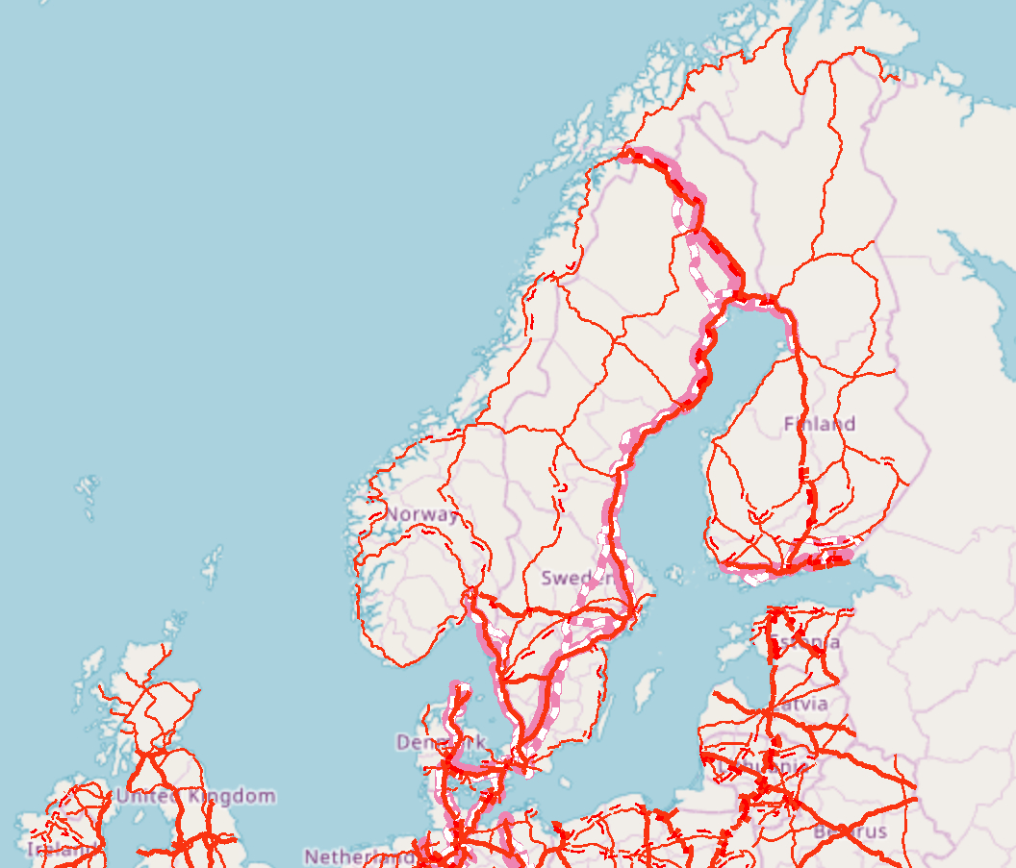
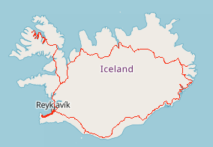

Proposed Cross-border Infrastructure
This map shows the proposed hydrogen stations for cross-border transport only.
Border crossing is supposed to require hydrogen stations within 100 km from the border. Stations may be located on both sides of the border.
Important ports for international goods and passenger transport are included, as they will play an important role for deployment of hydrogen in the Nordics.
Legend:
Cross-border stations for road transport
Ports for border-crossing (deployment time not specified)
© OpenStreetMap (and) contributors, CC-BY-SA, © European Commission – DG MOVE – 2018

Slide 24
Next Wave Recommendation
- for development of a Nordic Hydrogen Vision
Next Wave partners propose
Nordic Conferences presenting national policies and discussing how to cooperate to stimulate decarbonisation of heavy-duty transport in the Nordics
  Part of the Nordic Hydrogen Conference and national conferences
Assessment – What is needed to stimulate decarbonisation of heavy-duty transport in the Nordics
  Developed by the Next Wave partners, Autumn 2022
Note to the Nordic Council of Ministers for decision on common targets and actions to decarbonise heavy-duty transport in the Nordics
  Spring 2023

Slide 25



Thanks…
for your attention!
Photo: Lex Valishvili, Unsplash

